Slide 1
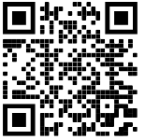
Hub Page for In-service 2022-2023

Slide 2
Phishing
Phishing is a type of attack where a someone sends a fraudulent message designed to trick a person into revealing information to an attacker. Phishing is the most common attack performed by cybercriminals

Slide 3
Phishing
Users receive a email that looks legitimate but points to a site to try to get a users login.

Slide 4
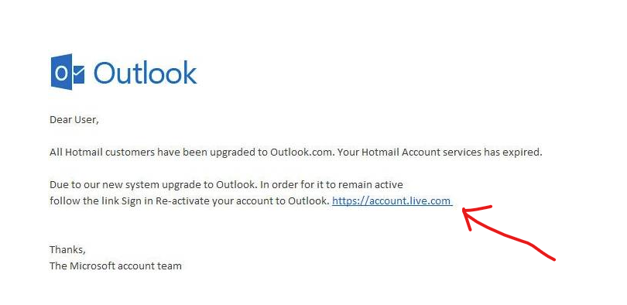
Phishing

Slide 5
Phishing

Slide 6
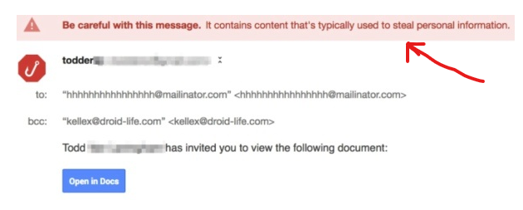
Phishing

Slide 7
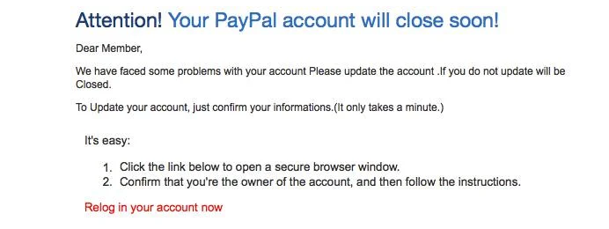
Phishing

Slide 8
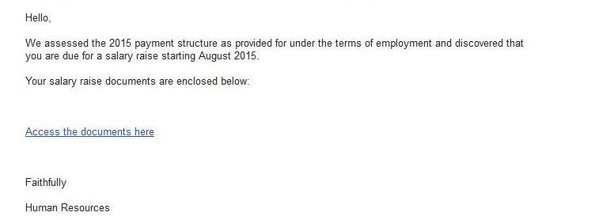
Phishing

Slide 9
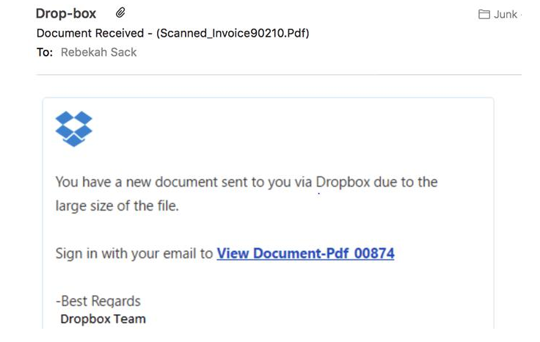
Phishing

Slide 10
Phishing
Fake warning email with a link to login to “check” your account.

Slide 11
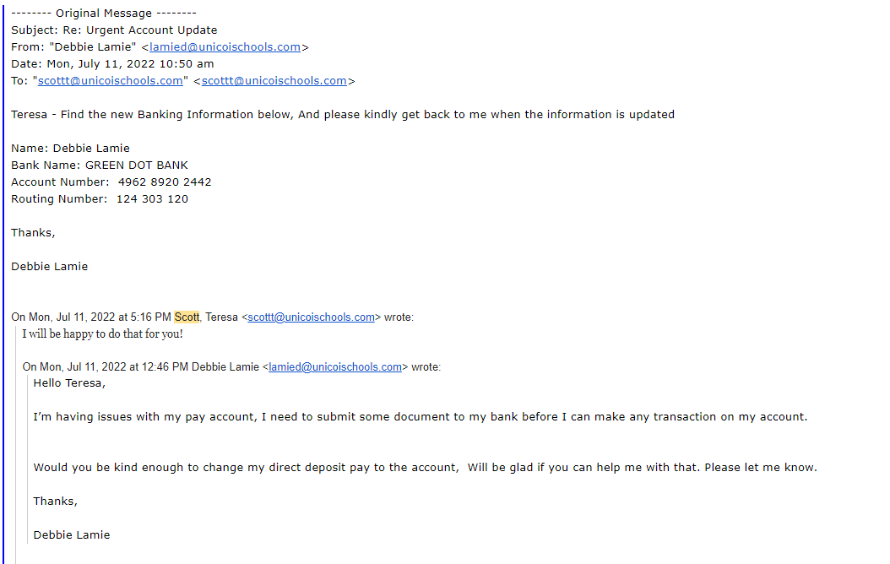
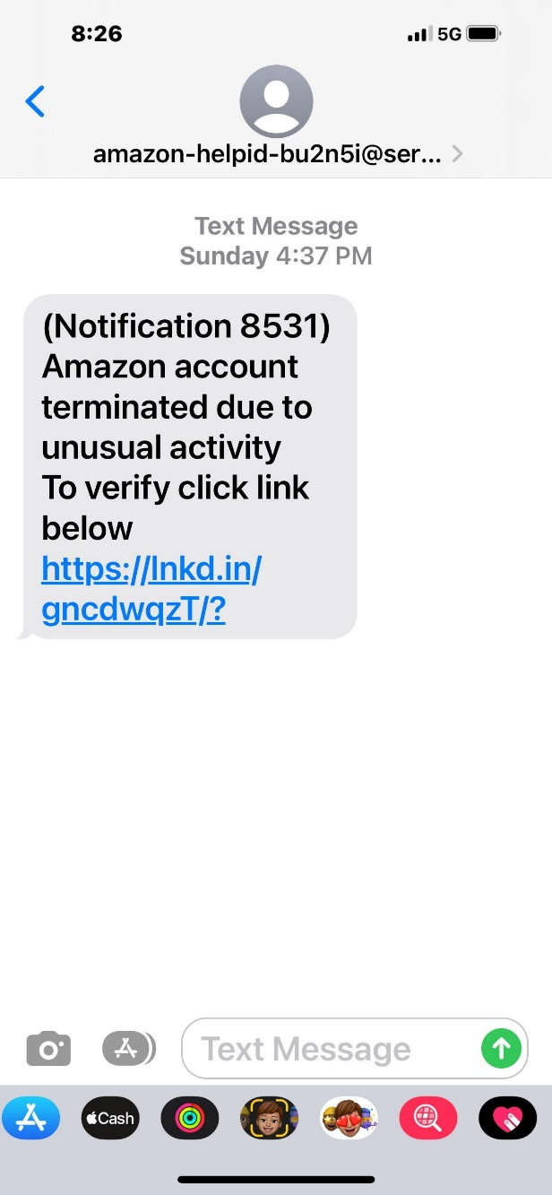
Phishing
Fake warning email with a link to login to “check” your account.

Slide 12
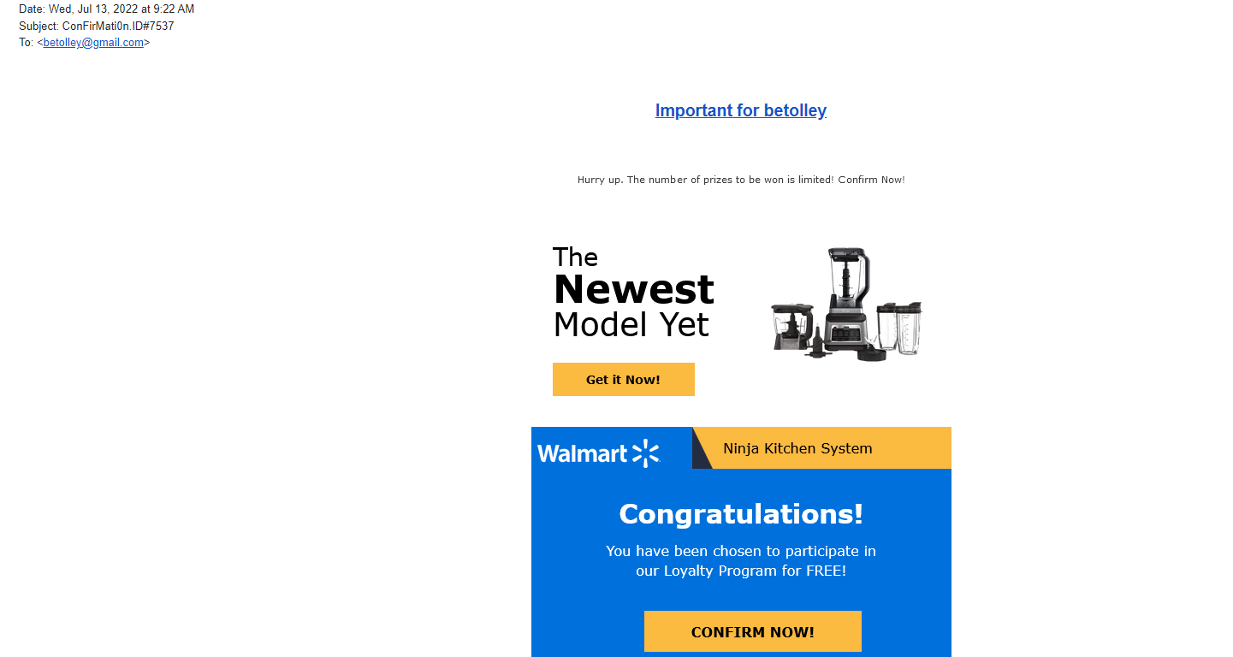
Phishing
Fake warning email with a link to login to “check” your account.

Slide 13
Phishing
This year we will be sending phishing emails to employees to see who opens them. We will provide a training video for those that click the links.

Slide 14
2nd Factor Authentication

Slide 15
What is it?
In recent years, we’ve witnessed a massive increase in the number of websites losing personal data of their users. And as cybercrime gets more sophisticated, companies find their old security systems are no match for modern threats and attacks. Sometimes it’s simple human error that has left them exposed. And it’s not just user trust that can be damaged. All types of organizations—global companies, small businesses, start-ups, and even non-profits—can suffer severe financial and reputational loss.

Slide 16
What is it?
For consumers, the after-effects of targeted hack or identity theft can be devastating. Stolen credentials are used to secure fake credit cards and fund shopping sprees, which can damage a victim’s credit rating.
Entire bank and cryptocurrency accounts can be drained overnight. A recent study revealed that in 2016 over $16 billion was taken from 15.4 million U.S. consumers. Even more incredible, identify thieves stole over $107 billion in the past six years alone.

Slide 17
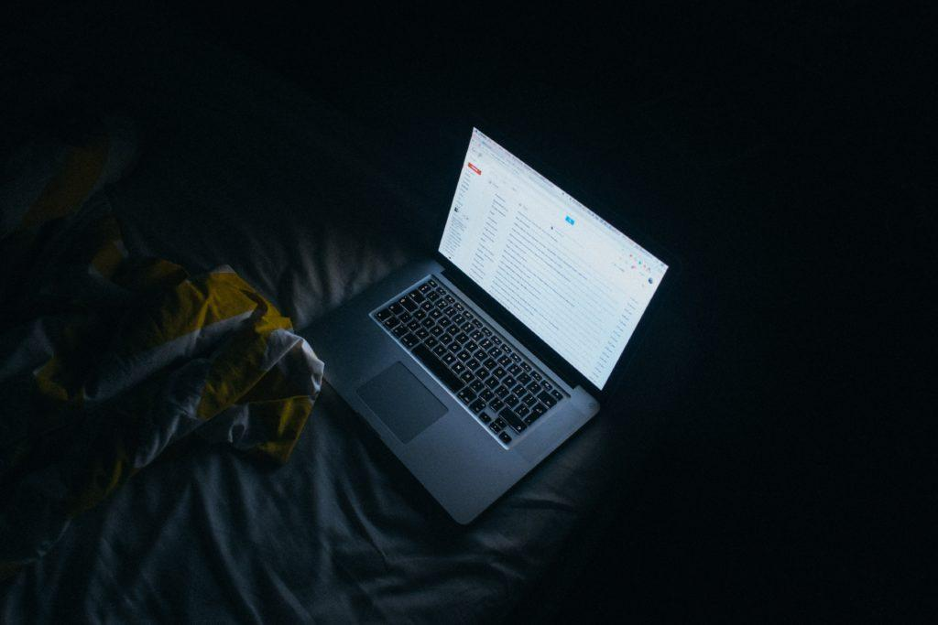
What is it?
Clearly, online sites and apps must offer tighter security. And, whenever possible, consumers should get in the habit of protecting themselves with something that’s stronger than just a password. For many, that extra level of security is two-factor authentication.

Slide 18
What is it?
Passwords: Historically Bad But Still In Use
Despite this, and the fact that there are much more secure alternatives, usernames and passwords remain the most common form of user authentication. The general rule of thumb is that a password should be something only you know while being difficult for anyone else to guess. And while using passwords is better than having no protection at all, they’re not foolproof.

Slide 19
What is it?
Humans have lousy memories. A recent report looked at over 1.4 billion stolen passwords and found that most were embarrassingly simple. Among the worst are “111111,” “123456,” “123456789,” “qwerty,” and “password.” While these are easy to remember, any decent hacker could crack these simple passwords in no time.

Slide 20
What is it?
Too many accounts: As users get more comfortable with doing everything online, they open more and more accounts. This eventually creates too many passwords to remember and paves the way for a dangerous habit: password recycling. Here’s why hackers love this trend: it takes just seconds for hacking software to test thousands of stolen sign-in credentials against popular online banks and shopping sites. If a username and password pair is recycled, it’s extremely likely it’ll unlock plenty of other lucrative accounts.

Slide 21
What is it?
2nd factor authentication or 2FA is an extra layer of security used to make sure that people trying to gain access to an online account are who they say they are. First, a user will enter their username and a password. Then, instead of immediately gaining access, they will be required to provide another piece of information.

Slide 22
What is it?
This second factor could come from one of the following categories:
Something you know: This could be a personal identification number (PIN), a password, answers to “secret questions” or a specific keystroke pattern
Something you have: Typically, a user would have something in their possession, like a credit card, a smartphone, or a small hardware token
Something you are: This category is a little more advanced, and might include biometric pattern of a fingerprint, an iris scan, or a voice print

Slide 23
What is it?
With 2FA, a potential compromise of just one of these factors won’t unlock the account. So, even if your password is stolen or your phone is lost, the chances of a someone else having your second-factor information is highly unlikely.

Slide 24
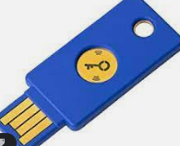
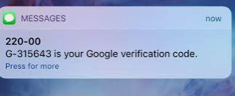
What is it?
Hardware Tokens for 2FA
Hardware tokens are small, like a key fob, automatically transfer the 2FA code when plugged into a computer’s USB port.
SMS Text-Message
SMS-based 2FA interacts directly with a user’s phone. After receiving a username and password, the site sends the user a unique one-time passcode (OTP) via text message. Like the hardware token process, a user must then enter the OTP back into the application before getting access.

Slide 25
Why Do we need it?
We are being required to use 2FA for all employees to access any system with secure data by our insurance provider.
This included:
Google Skyward Anything that uses Google. All Servers

Slide 26
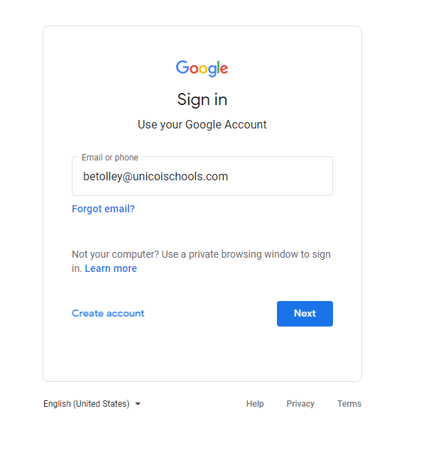

Slide 27
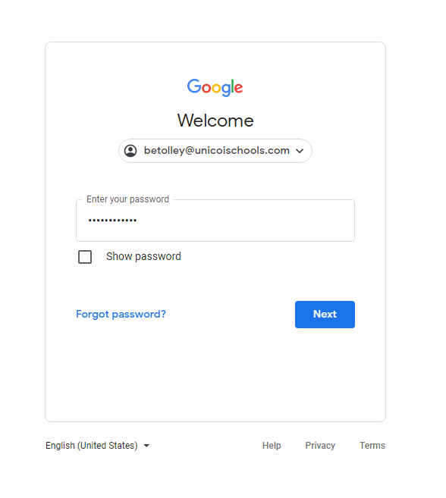

Slide 28
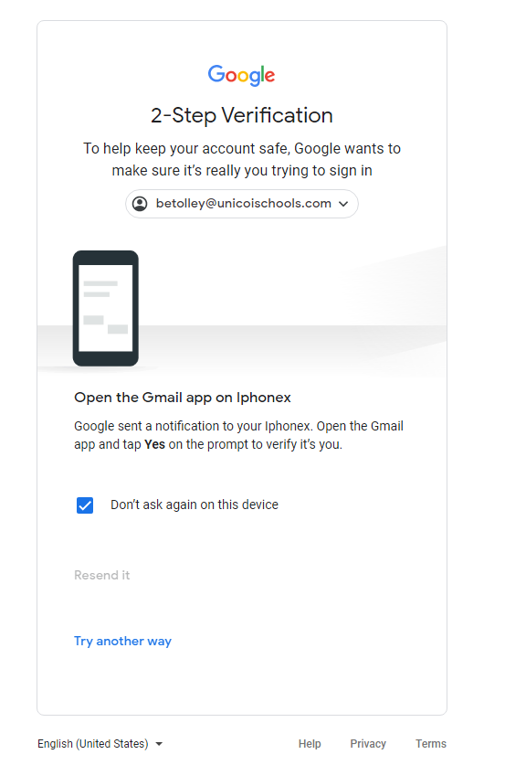
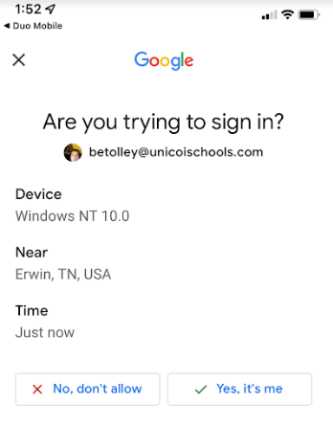
Gmail APP

Slide 29
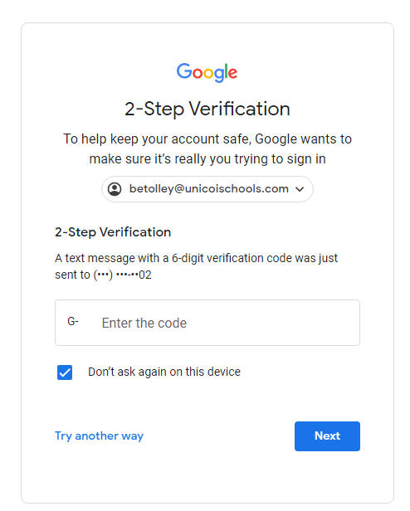
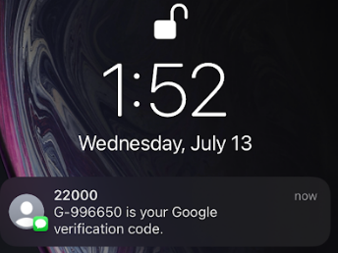
Text Message

Slide 30
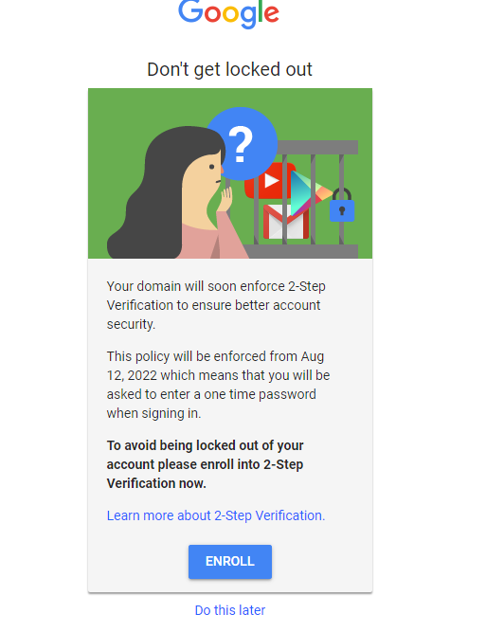
2FA Setup

Slide 31
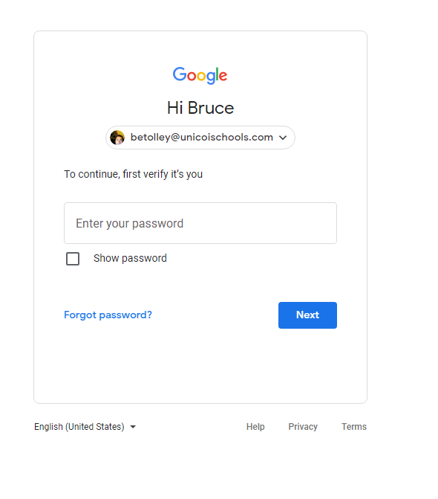
2FA Setup

Slide 32
2FA Setup

Slide 33
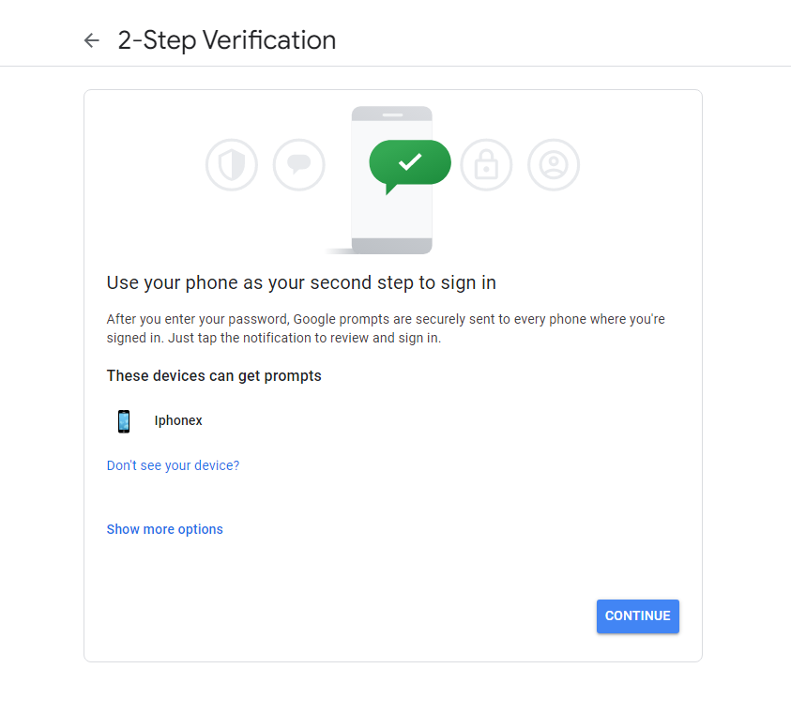
2FA Setup

Slide 34
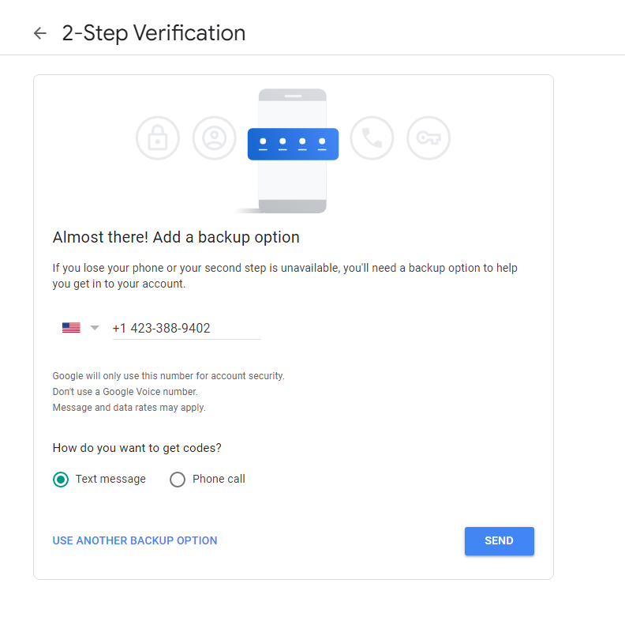
2FA Setup

Slide 35
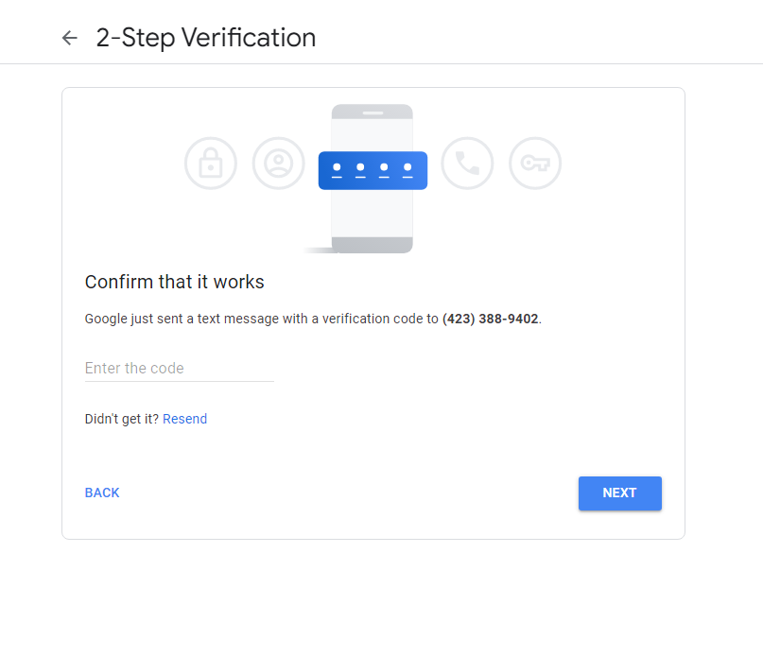
2FA Setup

Slide 36
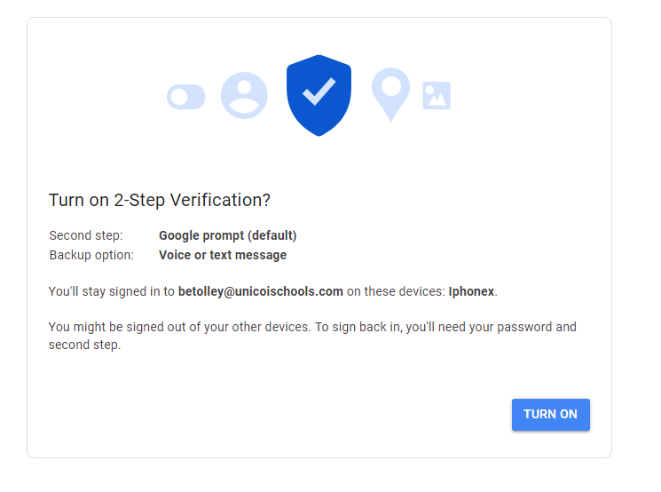
2FA Setup

Slide 37
Why Do we need it?
Starting August 12th we will require 2FA on our login to all systems.

